Slide 1

Wine datset
Presented by
NELOFER SHAIK

Slide 2

INTRODUCTION
Wine quality is influenced by a variety of chemical properties that affect its taste, aroma, and overall sensory experience. With the rise of data-driven approaches, machine learning models can now analyze these measurable properties to classify wines more accurately and efficiently. This project aims to explore how different physicochemical attributes of red wine—such as acidity, alcohol content, sugar levels, and sulphates—relate to its quality as rated by human tasters.
By leveraging supervised machine learning techniques, we aim to predict the quality of wine based on its chemical composition. This not only supports wine producers in maintaining consistent quality but also provides valuable insights into which features most influence consumer preferences. Two classification models—Decision Tree and Random Forest—are trained, evaluated, and compared to identify the more accurate approach for predicting wine quality.

Slide 3

OBJECTIVES
To analyze the correlation between physicochemical properties and wine quality.
To apply Decision Tree and Random Forest models for predicting wine quality.
To compare the performance of both models using metrics such as accuracy, precision, recall, and F1-score.
To interpret the role of key features like alcohol, volatile acidity, and residual sugar in quality prediction.

Slide 4
DATASET OVERVIEW
The dataset contains 1,599 samples of red wine, each described by 11 physicochemical features and a quality score.The target variable, quality, is an integer value ranging from 0 to 10, based on human sensory ratings.
Features include:
fixed acidity, volatile acidity, citric acid, residual sugar, chlorides,free sulfur dioxide, total sulfur dioxide,
density, pH, sulphates, and alcohol.
The data was sourced from the UCI Machine Learning Repository, a trusted open-source platform for academic datasets.
The dataset is well-suited for classification tasks, enabling the use of various supervised learning algorithms.

Slide 5
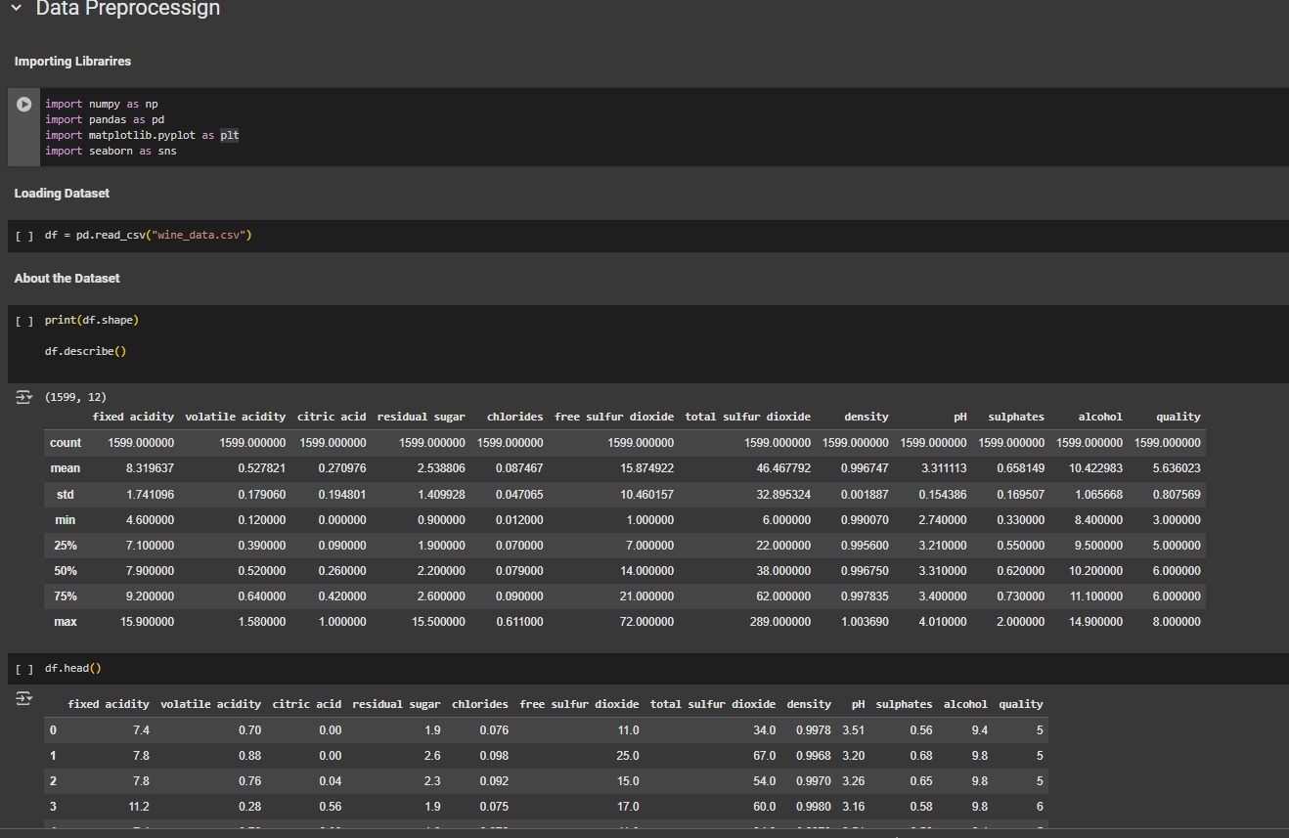
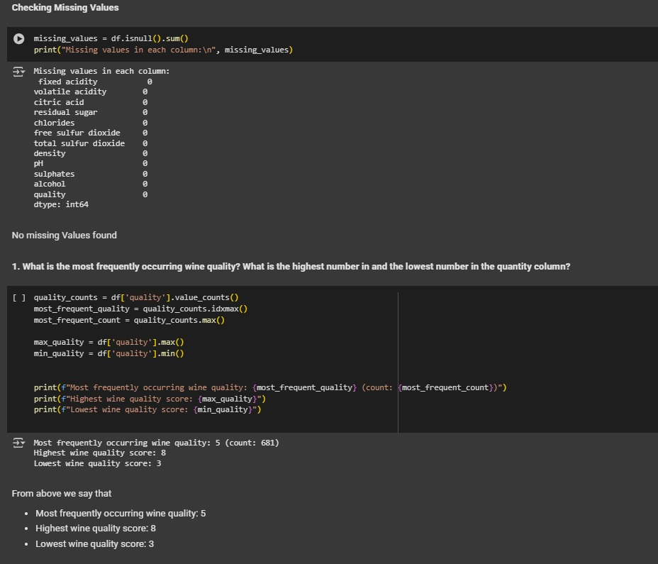
CODE IMPLEMENTATION

Slide 6
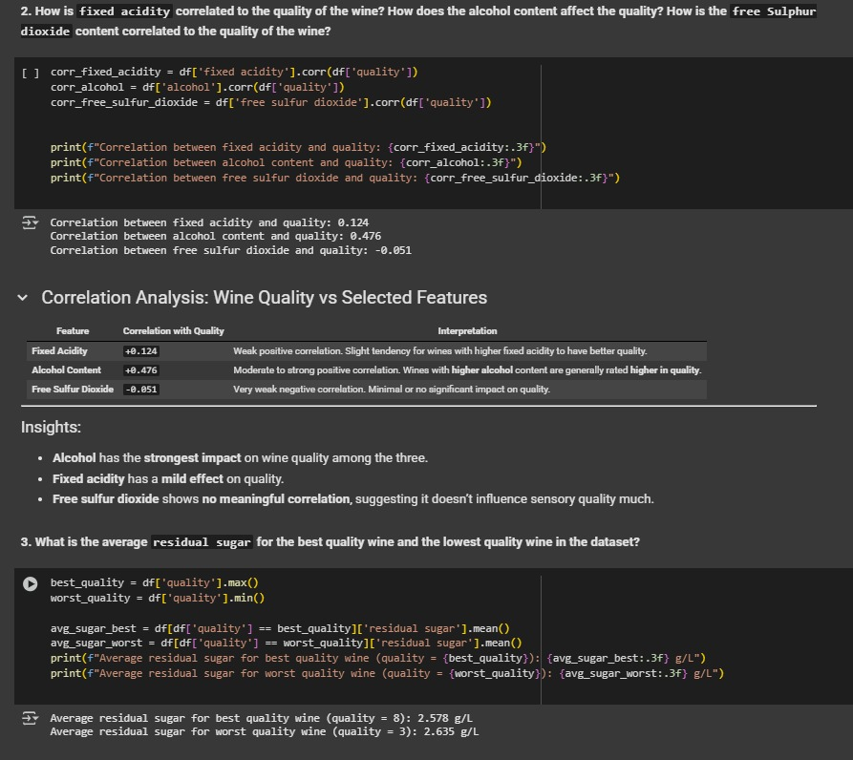
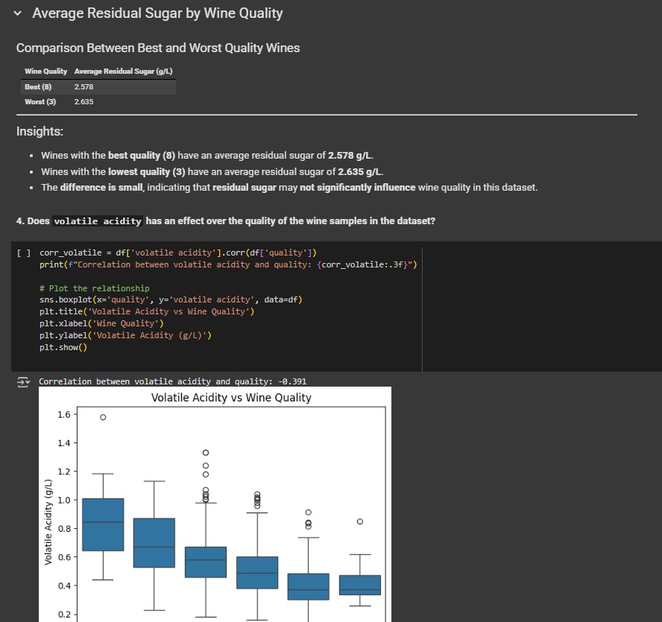

Slide 7
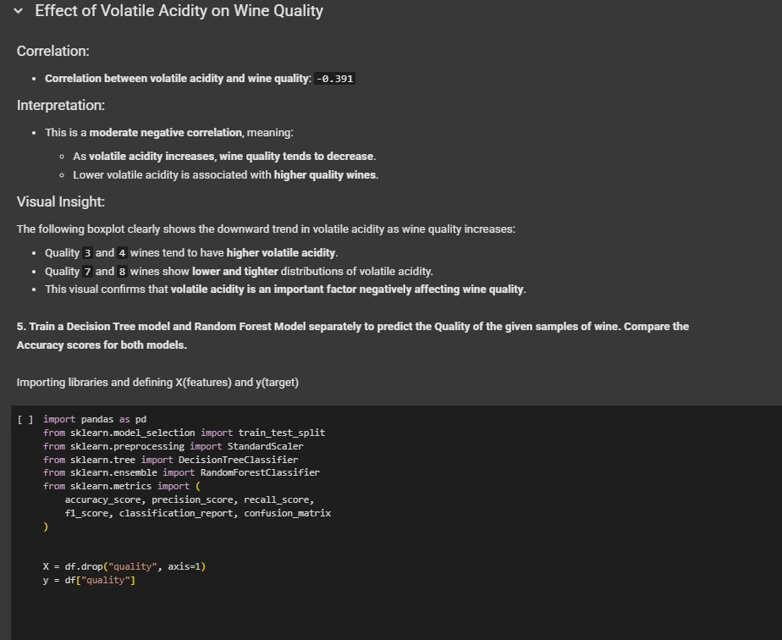
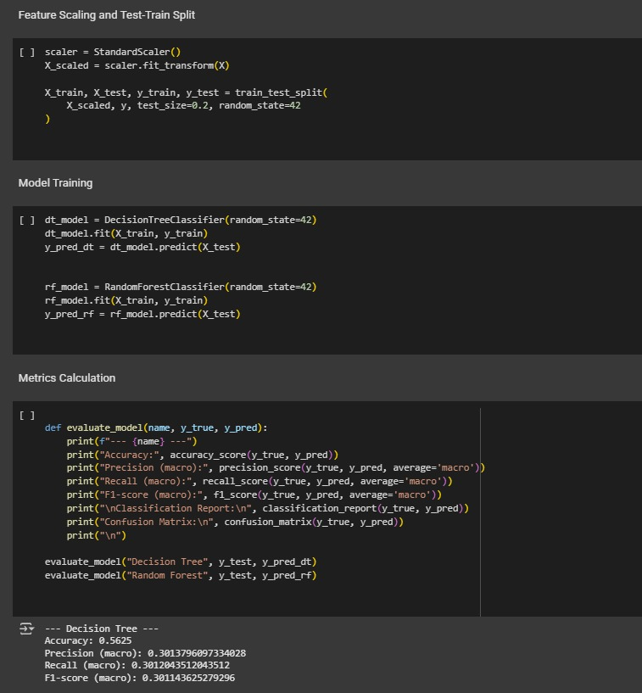

Slide 8
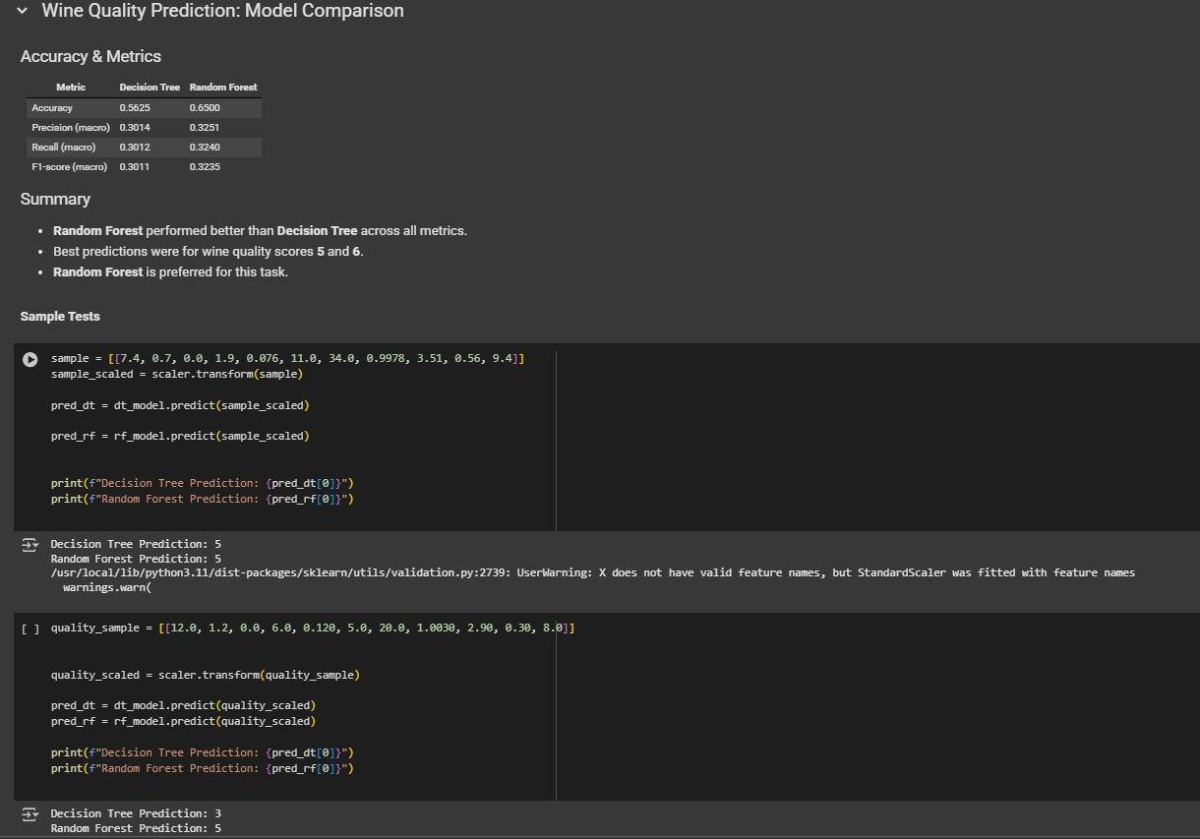
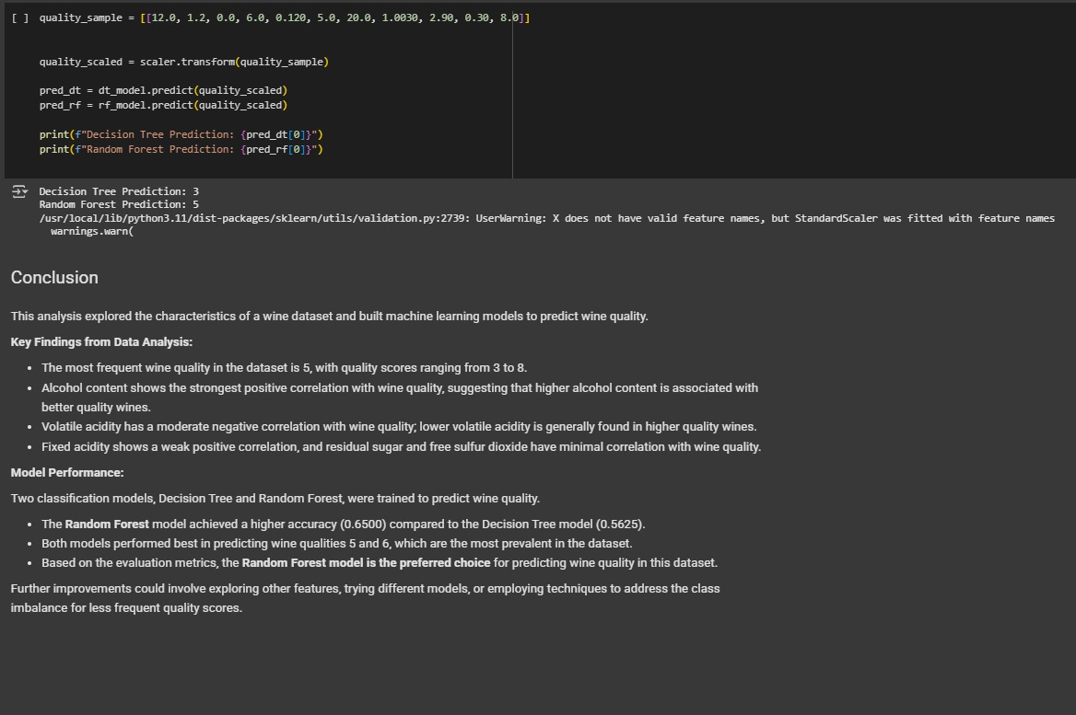

Slide 9
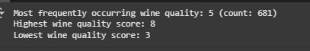
Question1 What is the most frequently occurring wine quality? What is the highest number in and the lowest number in the quantity column?
Code:
quality_counts = df['quality'].value_counts()
most_frequent_quality = quality_counts.idxmax()
most_frequent_count = quality_counts.max() max_quality = df['quality'].max()
min_quality = df['quality'].min() print(f"Most frequently occurring wine quality: {most_frequent_quality} (count: {most_frequent_count})")
print(f"Highest wine quality score: {max_quality}")
print(f"Lowest wine quality score: {min_quality}")

Slide 10
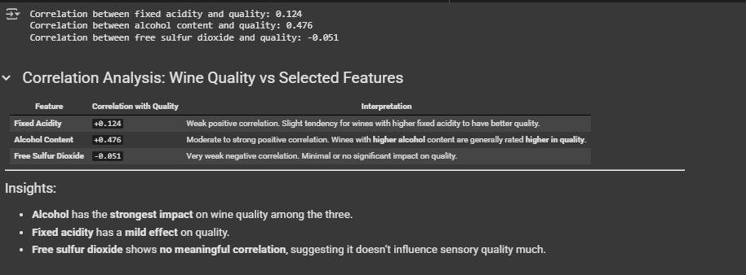
Question2: How is `fixed acidity` correlated to the quality of the wine? How does the alcohol content affect the quality? How is the `free sulphur dioxide` content correlated to the quality of the wine?
Code:
corr_fixed_acidity = df['fixed acidity'].corr(df['quality'])
corr_alcohol = df['alcohol'].corr(df['quality'])
corr_free_sulfur_dioxide = df['free sulfur dioxide'].corr(df['quality']) print(f"Correlation between fixed acidity and quality: {corr_fixed_acidity:.3f}")
print(f"Correlation between alcohol content and quality: {corr_alcohol:.3f}")
print(f"Correlation between free sulfur dioxide and quality: {corr_free_sulfur_dioxide:.3f}")

Slide 11
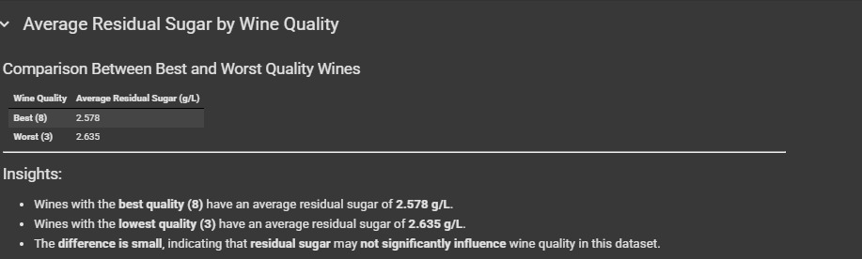
Question3: What is the average `residual sugar` for the best quality wine and the lowest quality wine in the dataset?
Code:
best_quality = df['quality'].max()
worst_quality = df['quality'].min() avg_sugar_best = df[df['quality'] == best_quality]['residual sugar'].mean()
avg_sugar_worst = df[df['quality'] == worst_quality]['residual sugar'].mean()
print(f"Average residual sugar for best quality wine (quality = {best_quality}): {avg_sugar_best:.3f} g/L")
print(f"Average residual sugar for worst quality wine (quality = {worst_quality}): {avg_sugar_worst:.3f} g/L")

Slide 12
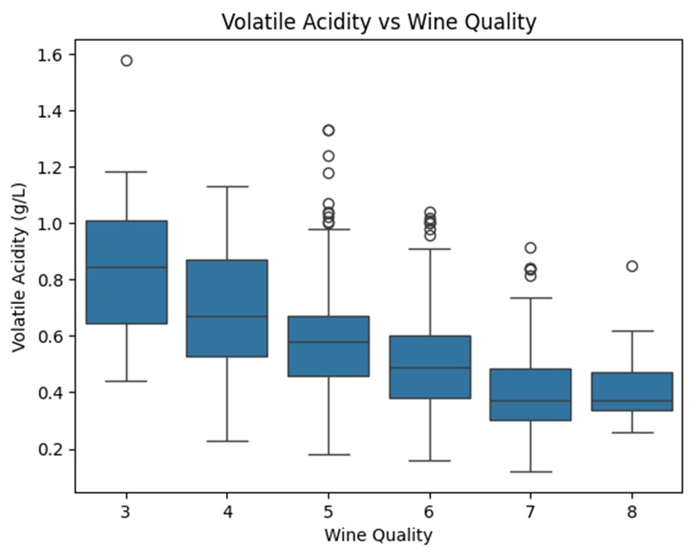
QUESTION4: Does `volatile acidity` has an effect over the quality of the wine samples in the dataset? .
Code:
corr_volatile = df['volatile acidity'].corr(df['quality'])
print(f"Correlation between volatile acidity and quality: {corr_volatile:.3f}")
sns.boxplot(x='quality', y='volatile acidity', data=df)
plt.title('Volatile Acidity vs Wine Quality')
plt.xlabel('Wine Quality')
plt.ylabel('Volatile Acidity (g/L)')
plt.show()

Slide 13
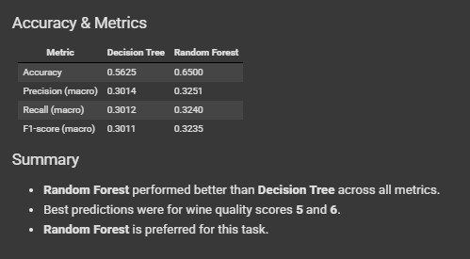
Question5: Train a decision tree model and random forest model separately to predict the quality of the given samples of wine. Compare the accuracy scores for both models. .
Code:
dt_model = DecisionTreeClassifier(random_state=42)
dt_model.fit(X_train, y_train)
y_pred_dt = dt_model.predict(X_test)
rf_model = RandomForestClassifier(random_state=42)
rf_model.fit(X_train, y_train)
y_pred_rf = rf_model.predict(X_test)

Slide 14
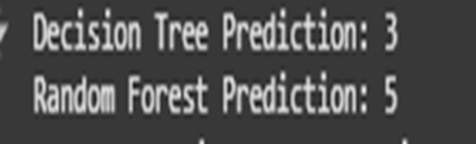
Sample Test
quality_sample = [[12.0, 1.2, 0.0, 6.0, 0.120, 5.0, 20.0, 1.0030, 2.90, 0.30, 8.0]] quality_scaled = scaler.transform(quality_sample) pred_dt = dt_model.predict(quality_scaled)
pred_rf = rf_model.predict(quality_scaled) print(f"Decision Tree Prediction: {pred_dt[0]}")
print(f"Random Forest Prediction: {pred_rf[0]}")

Slide 15

INSIGHTS GAINED
Alcohol content showed the strongest positive correlation with wine quality, suggesting higher alcohol often indicates better-rated wines.Volatile acidity had a significant negative correlation with quality, meaning higher acidity generally lowers wine ratings.Residual sugar had little influence on quality, indicating it may not play a key role in red wine evaluation.The Random Forest model outperformed the Decision Tree in all evaluation metrics, achieving higher accuracy, precision, and F1-score.Extreme quality values (e.g., 3 or 8) were harder to predict due to class imbalance in the dataset.

Slide 16

CONCLUSION
This project demonstrated how machine learning techniques can effectively be used to predict wine quality using physicochemical features. Through exploratory data analysis, we identified key attributes like alcohol and volatile acidity that strongly influence the overall quality score. Correlation analysis helped us understand the individual impact of each feature on wine ratings.We trained and evaluated two classification models: Decision Tree and Random Forest. Among the two, the Random Forest model consistently performed better in terms of accuracy and other evaluation metrics. The insights from this project not only help in selecting the right model but also highlight the most important chemical features for wine quality prediction.

Slide 17
THANK YOU
NELOFER SHAIK

